Slide 1
Show restraint healthy
presented by: Karen Andrea García Camargo
Presented to:Diana Escobar
Course: 10-01

Slide 2
¿which is a healthy lifestyle?
A thelthy way of life is a type of everyday attitudes that people do,exercision by eating five times day and taking the corresponding glasses of water daily, so a thelthy boby and an active mind is carried out.

Slide 3


Healthy ways of life every day
Have meaning of life and plan of action:
The autocare:

Slide 4


Healthy ways of life every day
Maintain self esteem the sense of belonging and identity:
participate in family activities

Slide 5
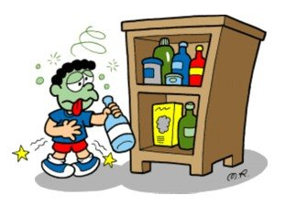
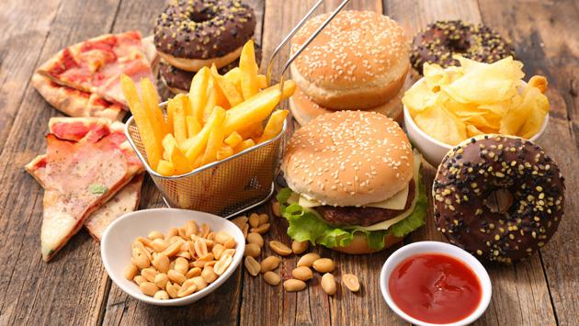
I am used not healthy life
do not use toxic subtances:
not appropriate diet:

Slide 6
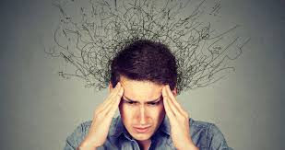

I am used not healthy life
Stress:
Environmental pollution:

